Slide 1
Visual Identity
RGU Team 2

Slide 2
App Name Ideas
UpSMART
Go SMART
UPcycle Glasgow
UPCycle AI
RePURPOSE
RIP Waste

Slide 3
Slogan Ideas
There is VALUE in waste!
RIP Waste

Slide 4




Logo Ideas
GLASGOW
UPCYCLE

Slide 5


Advertising Ideas
RIP Waste

Slide 6



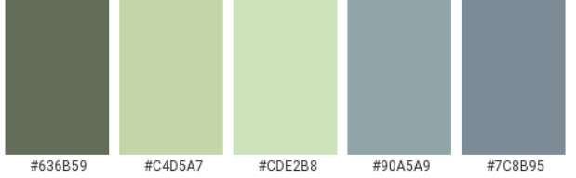

Colour Palette Ideas

Slide 7
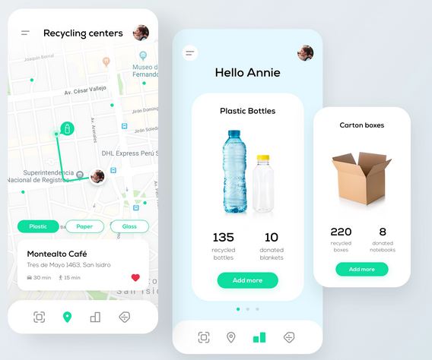
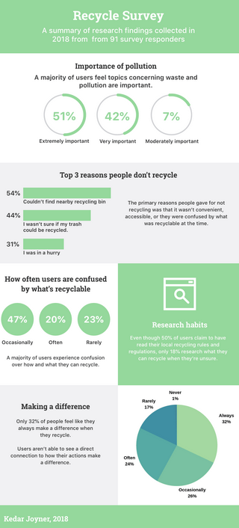
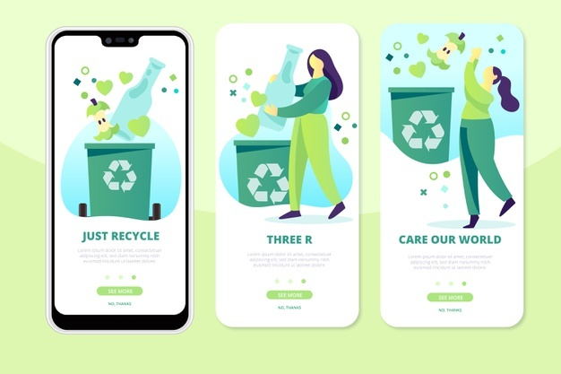
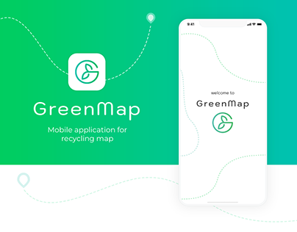
App/ design Ideas (1)

Slide 8
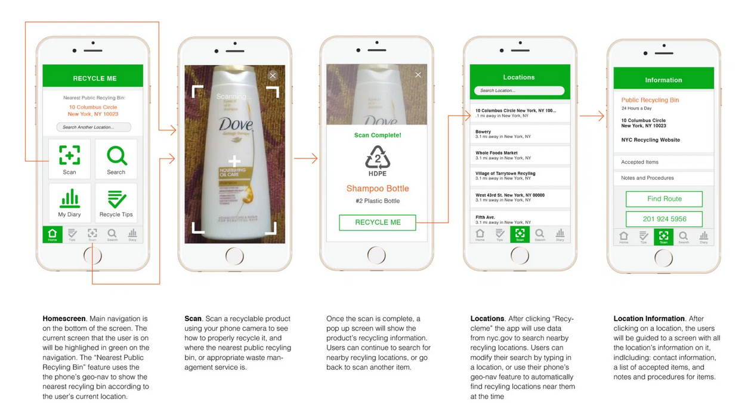
App/ design Ideas (2)

Slide 9
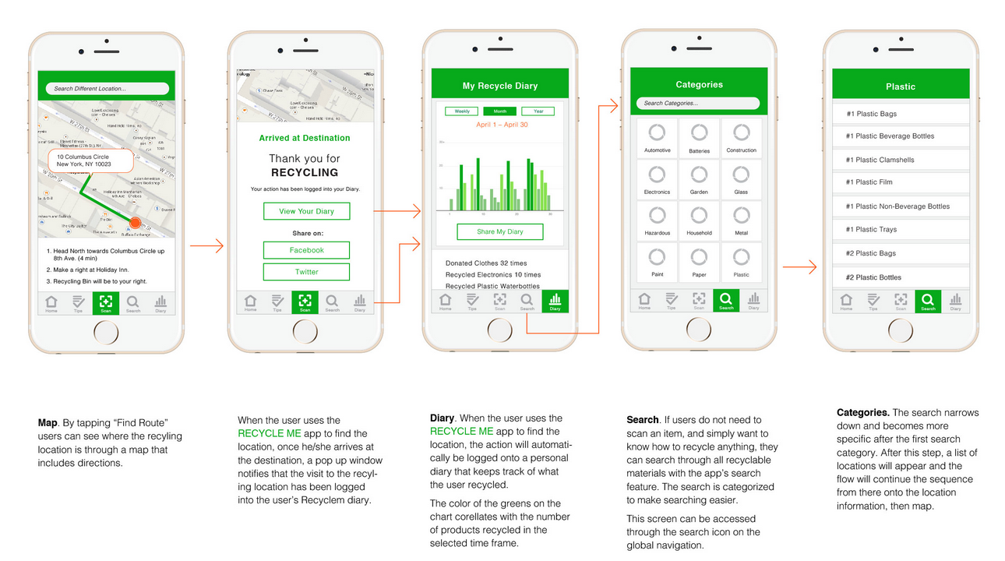
App/ design Ideas (3)

Slide 10
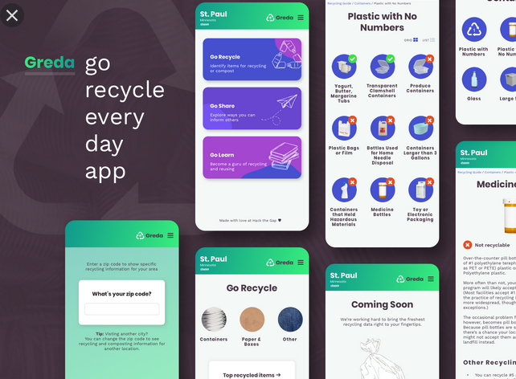
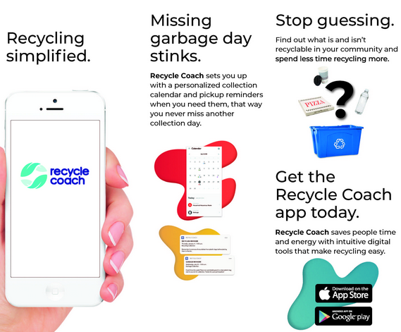
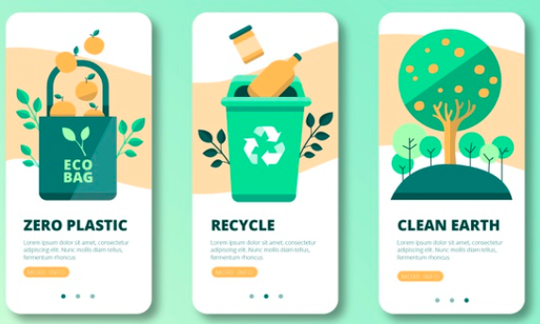
App/ design Ideas (4)

Slide 11
App/ design Ideas (5)

